Slide 1
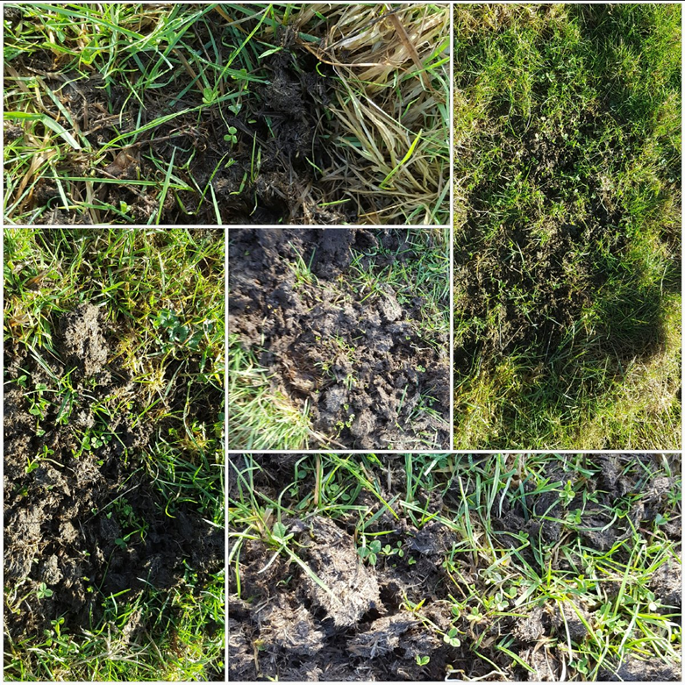
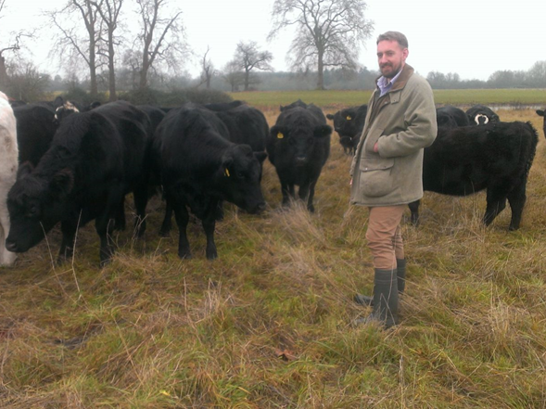
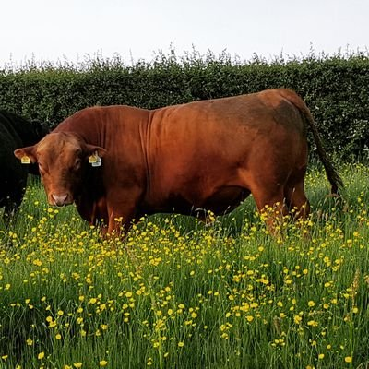


Diverse Pastures
Agricology Field Day
Phepson Farms, 30th July 2019
Notes:
Also a special welcome to Olivia who is the new Communications Assistant

Slide 2

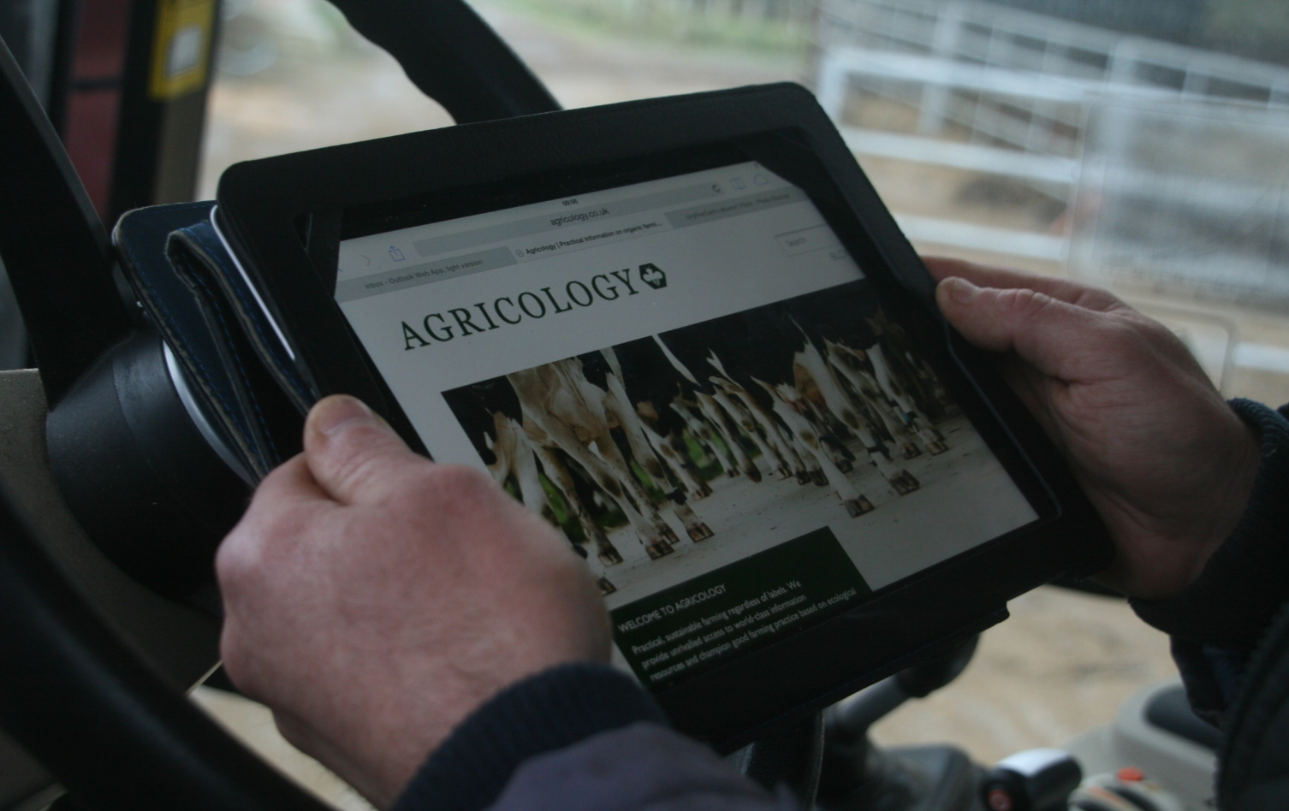


Agricology is a community of farmers, researchers and advisors sharing knowledge on sustainable farming
www.agricology.co.uk
Notes:
Online and in the field.. Bridging the gap between science and practice.. Here to help the transition to

Slide 3

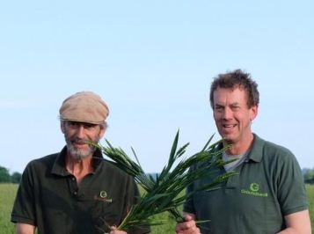
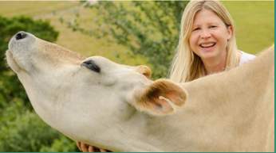
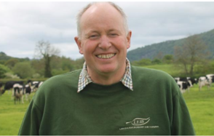
FARMERS AND GROWERS
Share their experiences of agroecology in practice
Learn more on their Farmer Profiles and on our YouTube channel
www.agricology.co.uk
@agricology
Notes:
We share practical experiences from
Farmers and Growers
on sustainable farming

Slide 4
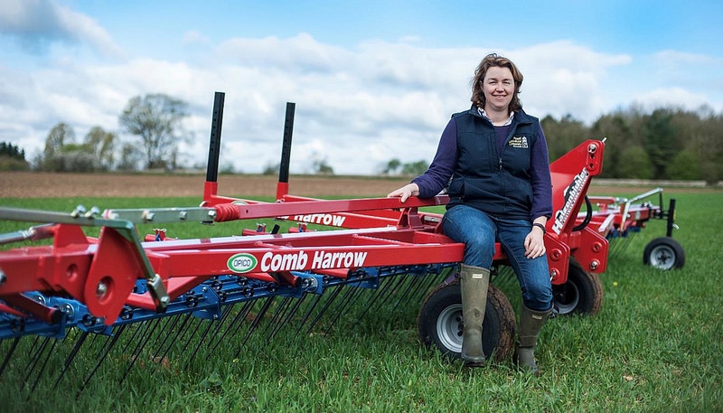
RESEARCHERS
Bring together the latest knowledge on agroecological solutions
New themes every month in our research trials and blogs
www.agricology.co.uk
Notes:
We bring together the latest ideas from
Researchers
on sustainable agriculture

Slide 5
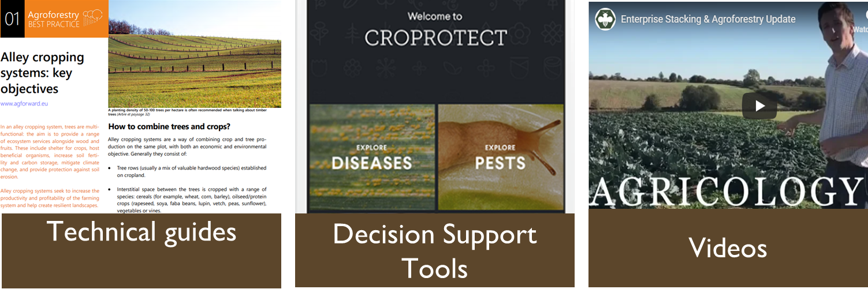
RESOURCE LIBRARY
Hosts over 350 practical tools on a wide range of agroecological topics and practices
www.agricology.co.uk
Notes:
We bring together the latest ideas from
Researchers
on sustainable agriculture

Slide 6
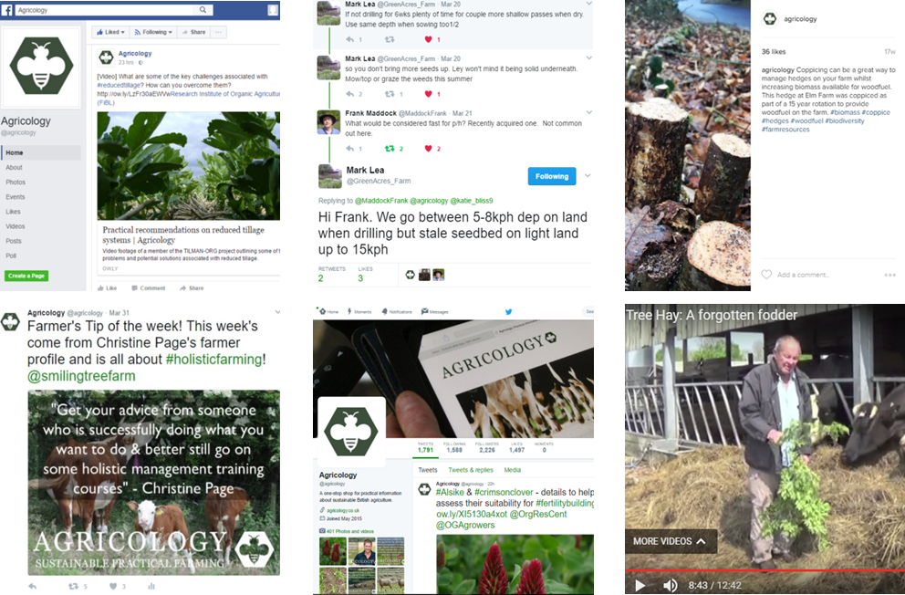
JOIN THE CONVERSATION!
Ask questions, share videos, photos and ideas on social media
@agricology
Notes:
We bring together the latest ideas from
Researchers
on sustainable agriculture

Slide 7
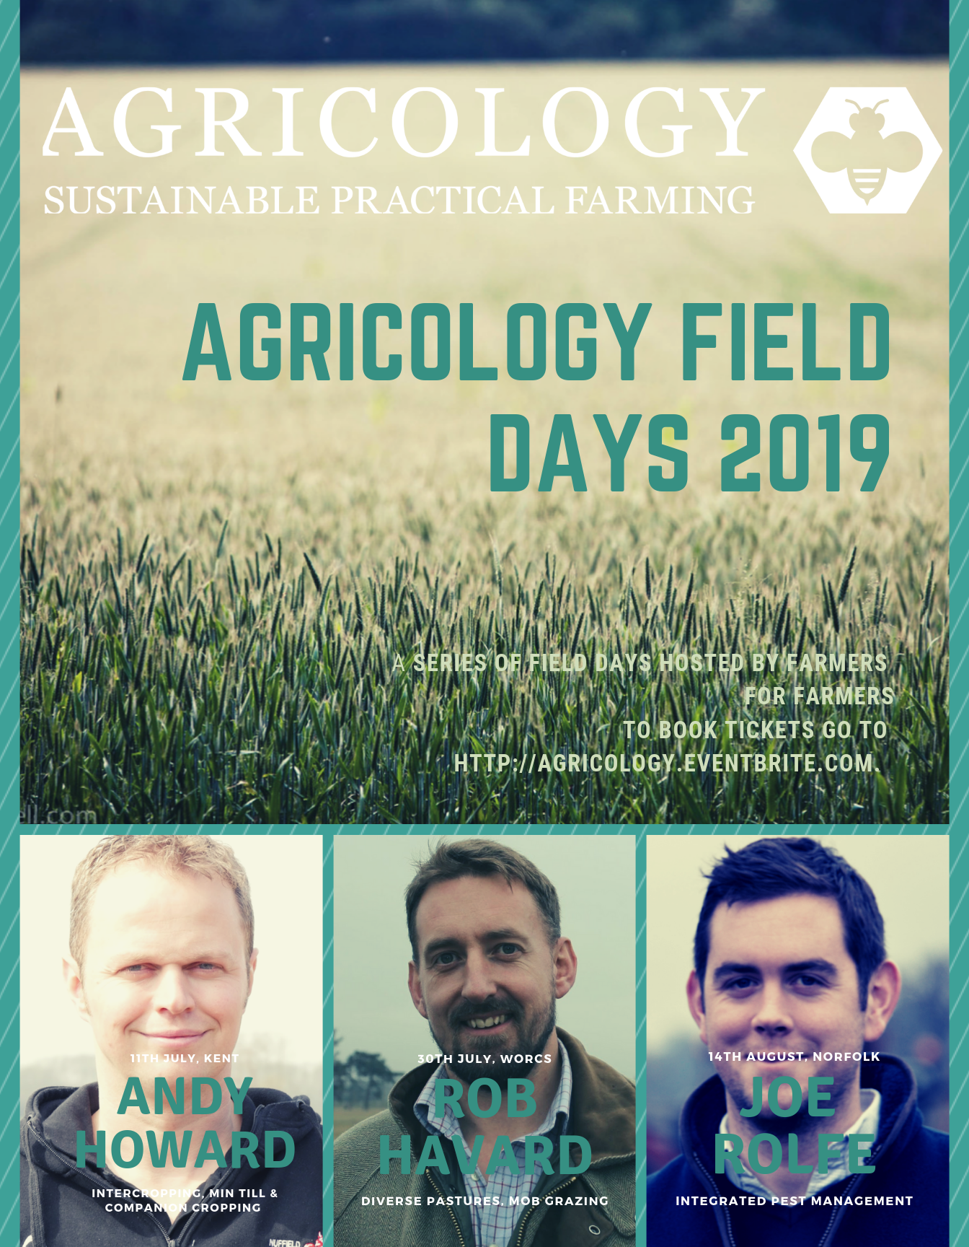
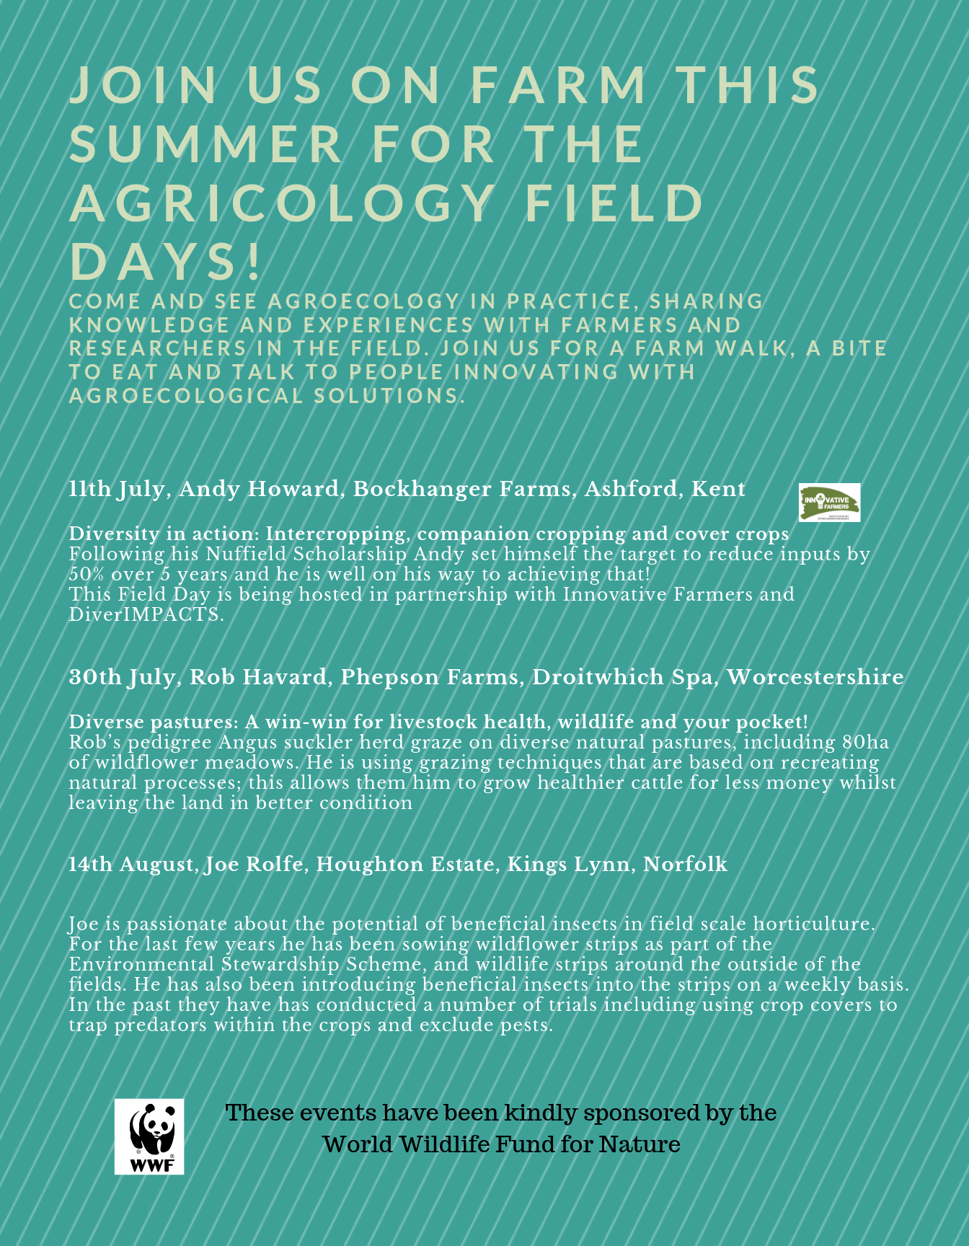

Slide 8
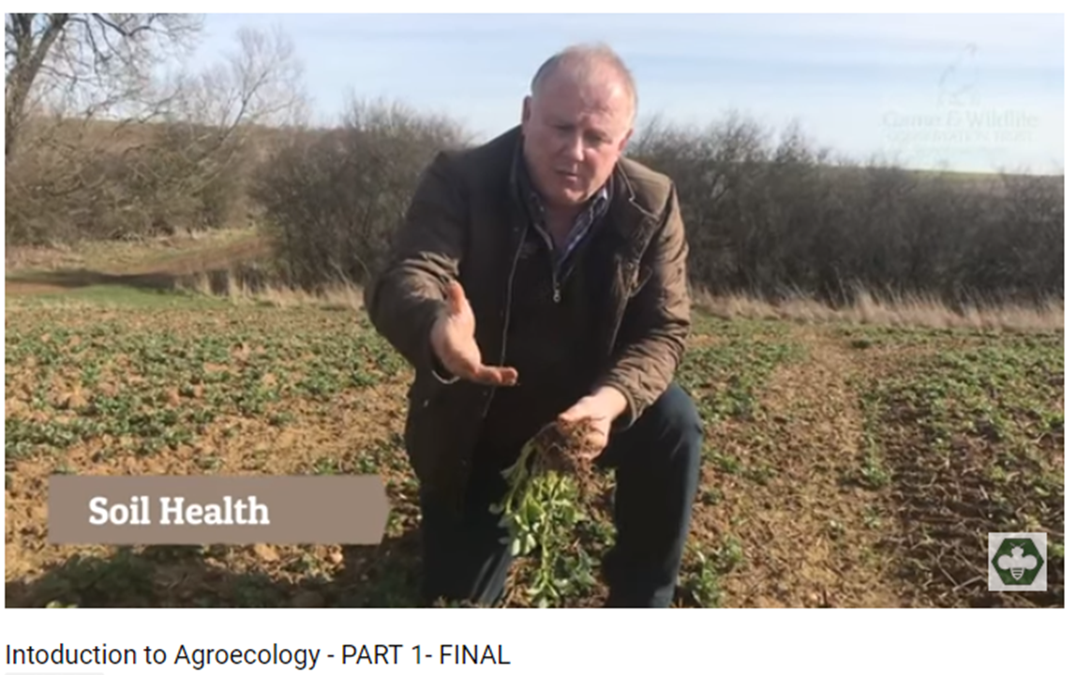
VIDEOS
Practical videos from the field on our YouTube channel
www.agricology.co.uk
Notes:
We bring together the latest ideas from
Researchers
on sustainable agriculture

Slide 9
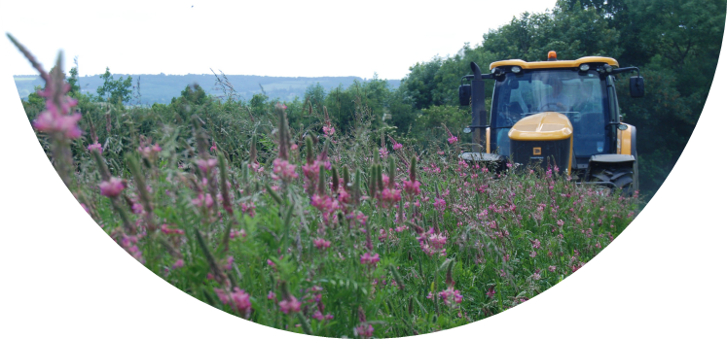
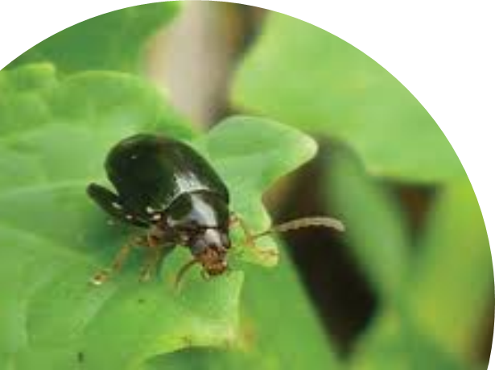
E-NEWSLETTER
Monthly themes on arable, horticulture and livestock systems
Pest of the month! Agroecological solutions to your problems!
www.agricology.co.uk
Notes:
We bring together the latest ideas from
Researchers
on sustainable agriculture

Slide 10

Bringing together the latest knowledge on agroecology from research and practice
www.agricology.co.uk
@agricology

Slide 11
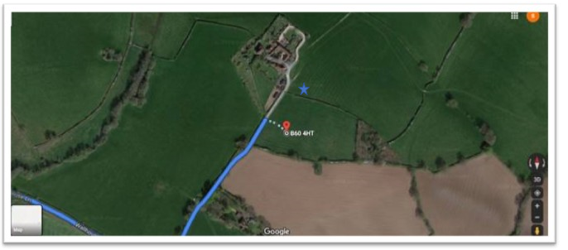
B60 4HT

