Slide 1


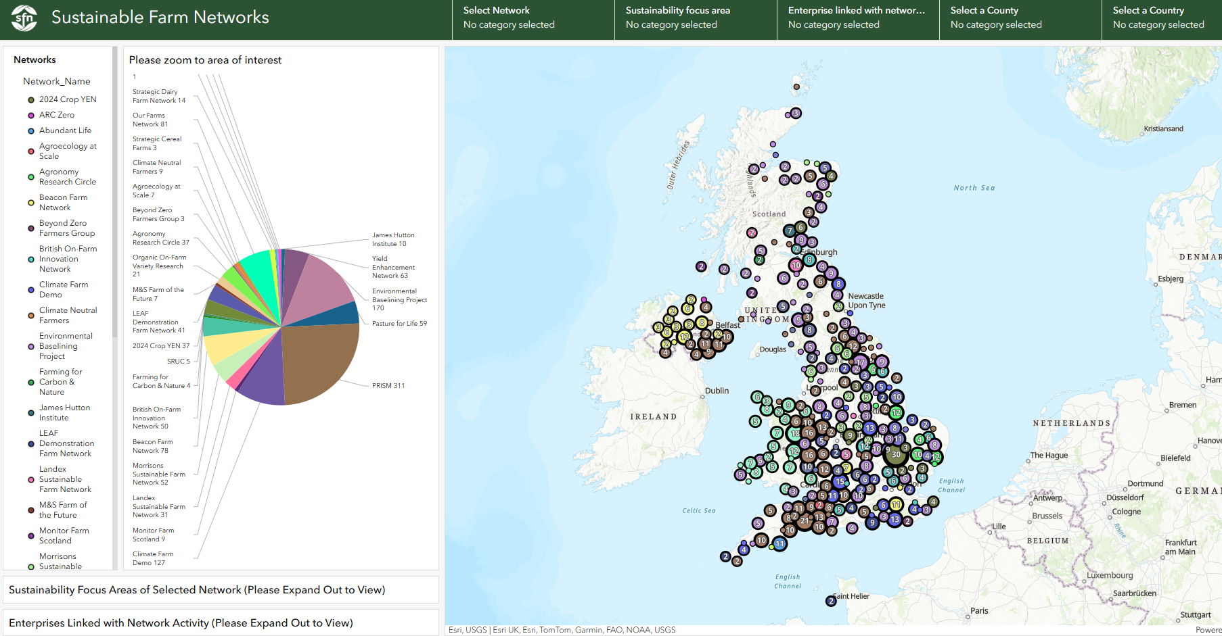
SFN network members
29/36 members
= 1411 points
​
Map update & consultation underway​
Nov 25
Sustainable Farm Networks

